Slide 1

LINUX NETWORKING USAGE
Revision 1.0
By: Truong Ho
Course duration: 1 hour
Last update: Jul 2009

Slide 2

Course Objectives
Intended Audience: basic Linux-understanding user.
Intended Linux type: CentOS.
At the end of the course, you will be able to:
Use 4 commands to access Linux services.
Configure basic network interface information.
Objectives of the course:
  Basic command concepts.
  Command usage.
  Troubleshoot the services during using command.

Slide 3


Content outline
    Basic concepts and usage details:
        “ifconfig” command
        FTP service
        SSH service
        NFS service
    Q&A

Slide 4

Section #1: Basic concepts
Basic concepts

Slide 5
Basic concepts – “ifconfig” command
Description:
  Short for “interface configurator”
  Configure, control, and query network interfaces information
Common usages:
  #ifconfig eth0: query interface information
  #ifconfig eth0 [down|up]: bring down/up interface
  #ifconfig eth0 192.168.230.129 netmask 255.255.255.0:
  Configure interface IP address
  #ifconfig eth0:1 172.30.49.4
  Configure secondary IP address for the interface (alias)
  #ifconfig eth0 netmask 255.255.255.0
  Change the subnet mask for the interface
Reference: #man ifconfig

Slide 6
Basic concepts – “ifconfig” command (cont)
Work-around:
  #setup then choose “Network configuration” to configure using GUI
  Navigate to folder /etc/sysconfig/network-scripts/ then open
  ifcfg-eth0 to configure the interface manually. Reboot the system to take effect or “#service network restart”
Static IP config | Dynamic IP config
DEVICE=eth0 IPADDR=192.168.0.2 NETMASK=255.255.255.0 NETWORK=192.168.0.0 BROADCAST=255.255.255.255 GATEWAY=192.168.0.1 ONBOOT=yes TYPE=Ethernet | DEVICE=eth0 BOOTPROTO=dhcp ONBOOT=yes TYPE=Ethernet

Slide 7
Basic concepts – FTP service
Description:
  File Transfer Protocol: to exchange files between client and server. Using TCP protocol with ports 21 and 20.
  Many kinds of daemon. In CentOS, we have one daemon called “gssftp” to activate the FTP server
  Usually started via xinetd service. Check path /etc/xinetd.d/gssftp for the configuration file
  Two working mode: active, passive
How to use:
  On the server side:
    Change “disable” to NO value on the gssftp configuration file
    Start “gssftp” daemon, via xinetd: #service xinetd restart
  On the client side:
    Use any FTP-support client tool such as: WinSCP, PuTTY.
    Connect to the server with proper account

Slide 8
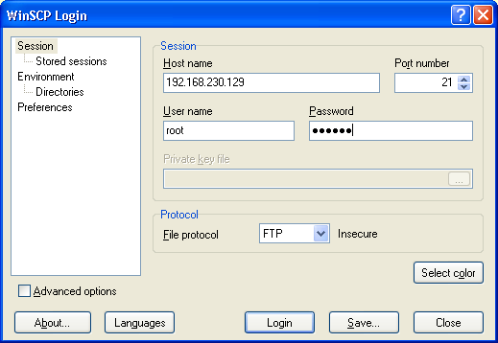
Basic concepts – FTP service (cont)
Example with WinSCP:
Troubleshoot:
  Cannot start xinetd service due to lack of daemon file
    Install the daemon: #yum –y install xinetd
    Check if the daemon file “xinetd” exists in /etc/init.d/ folder
    Start the service: #service xinetd <start|restart>

Slide 9
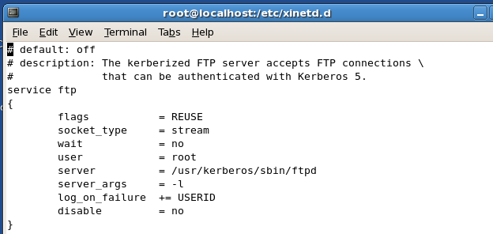
Basic concepts – FTP service (cont)
Troubleshoot (cont):
  Cannot connect to FTP server due to Kerberos authentication
    Basically gssftp service requires authentication via Kerberos from clients
    Remove parameter “-a” on the server_args line

Slide 10
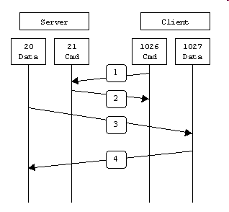
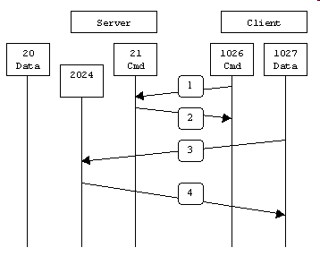
Basic concepts – FTP service (cont)
Active vs Passive
    Active mode Passive mode
    The FTP server is active or passive in initiating the FTP data transfer session

Slide 11
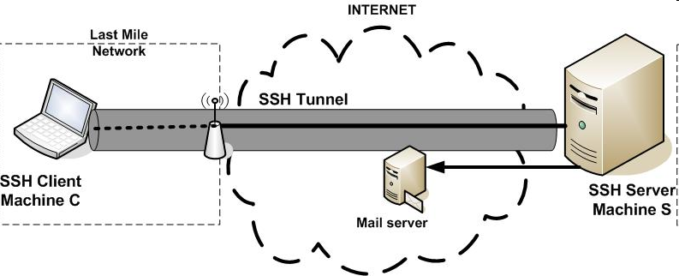
Basic concepts – SSH service
Description:
  “Secure Shell” allows data to be exchanged using a secure channel between two networked devices.
  All data exchanged between endpoints is encrypted.
  A replacement for telnet and all insecure remote shells.
  It can transfer files using the associated SFTP or SCP protocols. So it is preferred to use than FTP in file transfer.
  Mostly pre-installed on all Linux distributions.

Slide 12
Basic concepts – SSH service
Description (cont):
  SSH works with 3 steps: Host identification, Encryption, Authentication
  Host identification:
    Use public key cryptography
      Server –send PublicKey→ Client
      Client encrypts a random session key with server’s public key –send back → server.
    Session key is used to exchange data between them
  Encryption:
    All data will be encrypted during exchanging
    Mostly used protocols: 3DES, IDEA, Blowfish
  Authentication:
    Client is required to authenticate itself by providing “Username” and “Password”
Reference: http://winscp.net/eng/docs/protocols#protocol_comparison

Slide 13
Basic concepts – SSH service (cont)
How to use:
  Start the “sshd” daemon on the server if not already running:
    #service sshd start
  Using as telnet: PuTTY. To open a session for command manipulation.
  Using as FTP client: WinSCP. To open a transaction to the server then transfer file.
  * Setting up SSH daemon will be mentioned in another session

Slide 14
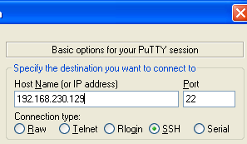
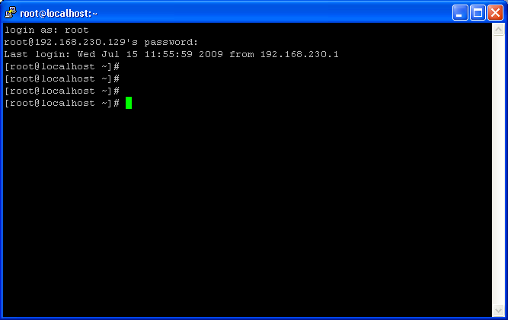
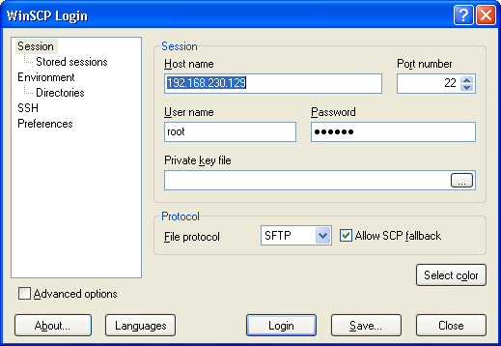
Basic concepts – SSH service (cont)
Examples:
  Connect using PuTTY for telnet session:
  Connect using WinSCP for transfer file session using SFTP protocol:

Slide 15
Basic concepts – NFS service
Description:
  Network File System to allow machines to mount a disk partition on a remote machine as if it were a local disk.
  Many Linux distros have this service installed as basic service.
  Started via RPC (Remote Procedure Call) service
  Acts with client-server model.
How to use:
  NFS server:
    “/etc/exports” file, to declare shared folder and access permission to this folder for clients.
    Examples:
    /truong/share 192.168.0.1(ro) 192.168.0.2(ro)
    /truong/common 192.168.0.1(rw) 192.168.0.2(rw)
    Use IP network address with subnet mask to support permission for clients in same IP range: 192.168.0.0/255.255.255.0(ro)

Slide 16
Basic concepts – NFS service (cont)
How to use:
  NFS server (cont):
    Configure for security reason
    Configure “/etc/hosts.deny” to deny all addresses
    Ex:
    portmap: ALL
    lockd: ALL
    mountd: ALL
    rquotad: ALL
    statd: ALL
    Configure “/etc/hosts.allow” to allow only address.
    Ex:
    portmap: 192.168.0.1 , 192.168.0.2
    lockd: 192.168.0.1 , 192.168.0.2
    mountd: 192.168.0.1 , 192.168.0.2
    rquotad: 192.168.0.1 , 192.168.0.2
    statd: 192.168.0.1 , 192.168.0.2

Slide 17
Basic concepts – NFS service (cont)
How to use:
  NFS server (cont):
    Start the NFS service. NFS serving is taken care of by 5 daemons:
    rpc.nfsd main file
    rpc.lockd, rpc.statd handle file locking
    rpc.mountd handles mount requests
    rpc.rquotad handles user file quotas on exported volumes
    Check that if portmapper daemon is started yet:
    #ps aux | grep portmap
    Start all NFS daemons:
    #service nfs <start|restart>
    Check if all daemons started and running successfully:
    #rpcinfo -p

Slide 18
Basic concepts – NFS service (cont)
How to use:
  NFS client:
    Also need portmapper already running and 2 daemons:
    rpc.lockd, rpc.statd handle file locking
    Start these daemons and check the status:
    → do the same ways as NFS server, just start the NFS services using command #service nfs <start|restart>
    Start to mount remote folder to local folder
    #mount remoteHost:remoteDir localDir
    ie: #mount 192.168.230.129:/my/share /my/localshare
    remoteDir must be absolute path on remoteHost
    Start mounting automatically during system bootup
    Add to the file /etc/fstab this line by following syntax:
    remoteHost:remoteDir localDir nfs defaults 0 0

Slide 19

Questions and Answers

Slide 20
Appendix: Course detail form
Author |  | Duration | n hours
Category | Software Engineering | Type | Theory and Practice
Examination | N/A
Intended Audience
Pre-requisites
Completion criteria for the course | Attendees must join at least 90% course length
Criteria for granting training waivers

Slide 21
Thank you
THANK YOU
Inquires regarding the above may be directed to:
Name, Position, email@cybersoft-vn.com

